Slide 1
Oscillator configuration

Slide 2
CONFIG1H: CONFIGURATION REGISTER 1 HIGH

Slide 3
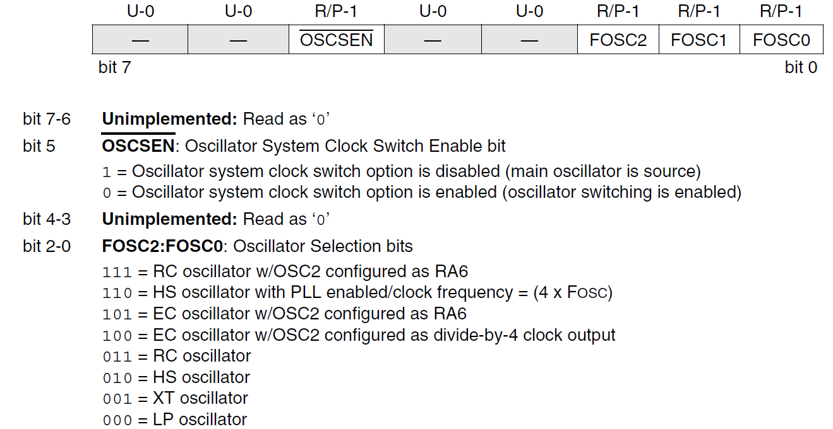

Slide 4
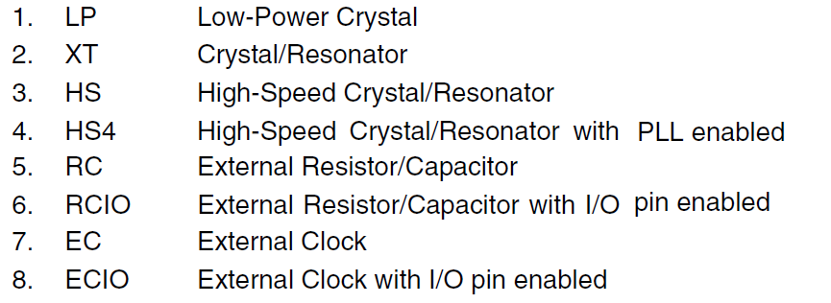
(Phase Lock Loop)

Slide 5
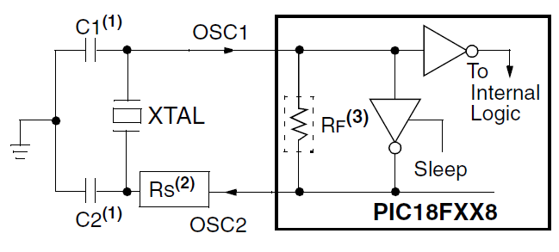
Crystal/ Ceramic resonator operation LP, XT, HS

Slide 6
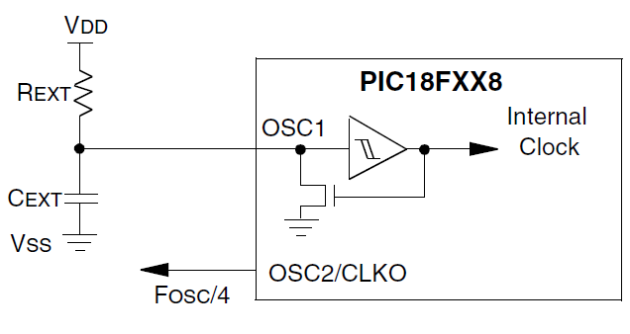
RC Oscillator mode

Slide 7
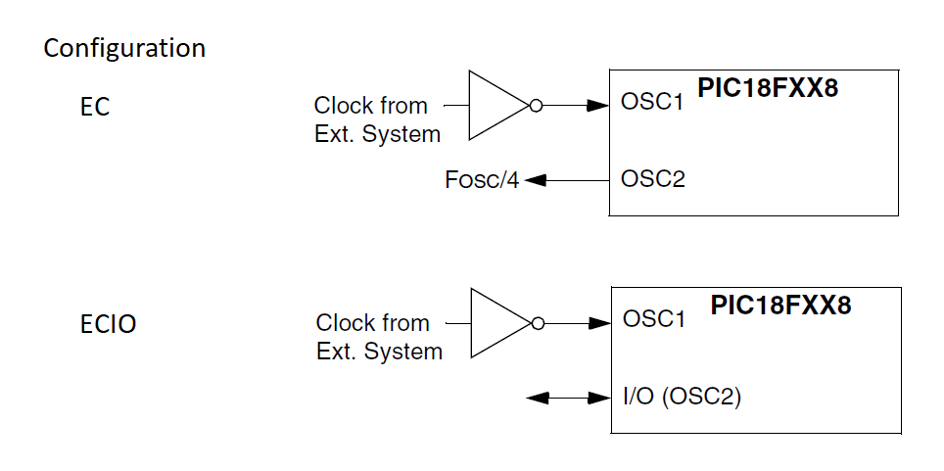

Slide 8
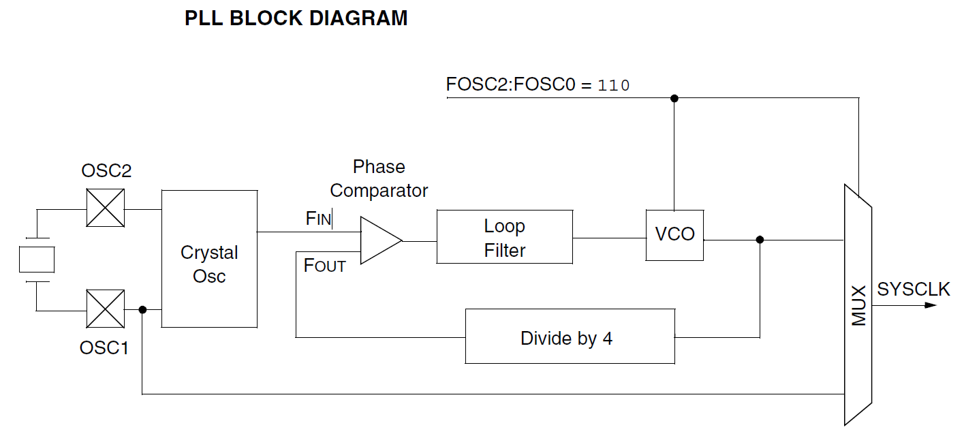

Slide 9
CONFIG2L: CONFIGURATION REGISTER 2 LOW

Slide 10
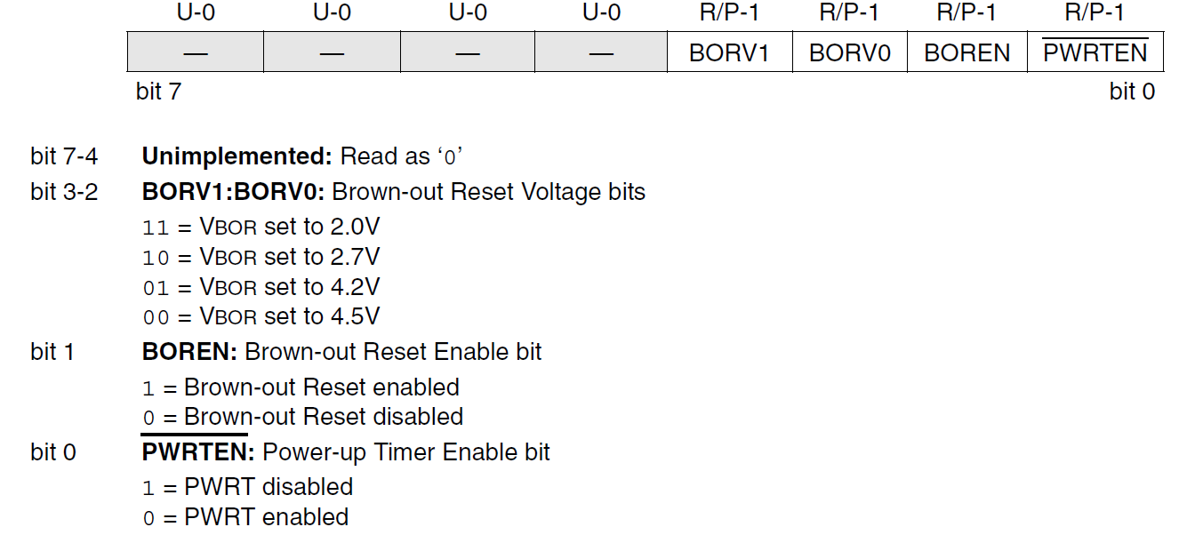

Slide 11
Reset operations
Power-on Reset (POR)
MCLR Reset during normal operation (Master CLeaR)
MCLR Reset during Sleep
Watchdog Timer (WDT) Reset during normal operation
Programmable Brown-out Reset (PBOR)
RESET Instruction
Stack Full Reset
Stack Underflow Reset

Slide 12
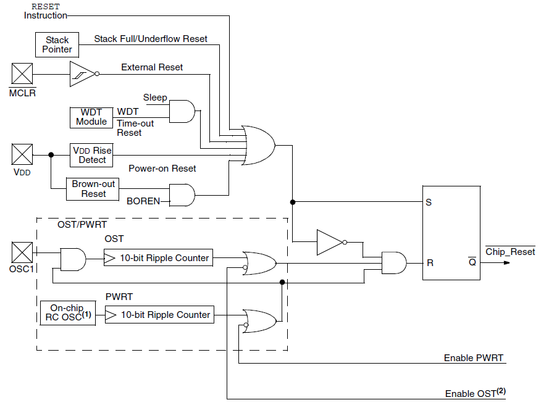

Slide 13
Power – on Reset (POR)
VDD pin has high.
An external RC component is used to create a POR delay.

Slide 14
_____ MCLR
External power on reset circuit
There is a noise filter in the reset path, that detects and ignores small pulses.
MCLR can be connected to VDD to avoid the RC component

Slide 15
Power- up Timer (PWRT)
It operates on an internal RC oscillator.
The chip is in Reset as long as the PWRT is active.
CONFIG2L register has the corresponding bit
The PWRT’s time delay allows VDD to rise to an acceptable level.

Slide 16
Oscillator Start-up Timer(OST)
It provides a 1024 oscillator cycle delay after the PWRT delay is over.
This additional delay ensures that the crystal oscillator or resonator has started and stabilized.
It is invoked only for XT, LP, HS and HS4 modes.
It is used in POR and wake-up from sleep

Slide 17
PLL lock time-out
A portion of the power-up timer is used to provide a fixed time-out
It is sufficient for the PLL to lock to the main oscillator frequency.
PLL lock time-out is typically 2 ms
It follows the oscillator start-up time-out(OST)

Slide 18
Brown-out Reset (BOR)
BOREN – BOR Enable configuration bit in CONFIG2L
It can disable or enable BOR circuitry.

